Slide 1
Title: Student Performance Analysis using PySpark
Subtitle: Mini Project (BDA)
Ch Thirmal Raju
CSE : section -2
Malla Reddy University Hyd

Slide 2
Project Objective
Analyze student marks across multiple subjects (Python, Java, MERNStack, M1, M2).
Identify trends in performance across sections.
Find correlations between subjects.
Recognize top and low performers.
Provide actionable suggestions to improve academic performance.

Slide 3
Dataset Details
Filename: MruStudentsdata.csv
Number of records: 520 students
Column | Description
RollNo | Unique student ID
Name | Student name
Section | Student section
Python | Marks in Python
Java | Marks in Java
MERNStack | Marks in MERN Stack
M1 | Marks in M1
M2 | Marks in M2

Slide 4
Tools & Technologies
Data Processing: PySpark
Data Manipulation: Pandas
Visualization: Matplotlib, Seaborn
Notebook Environment: Jupyter Notebook

Slide 5
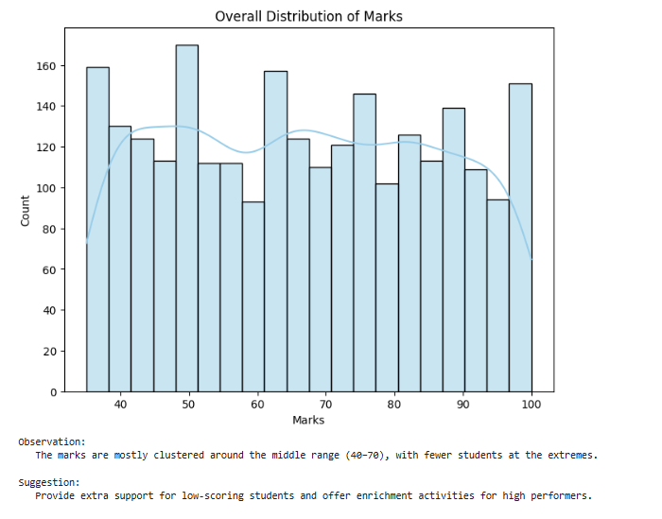
Overall Marks Distribution
Include histogram of all marks.
Observation: Most marks are clustered in the mid-range (40–70).
Suggestion: Support low scorers and provide enrichment for high performers.

Slide 6
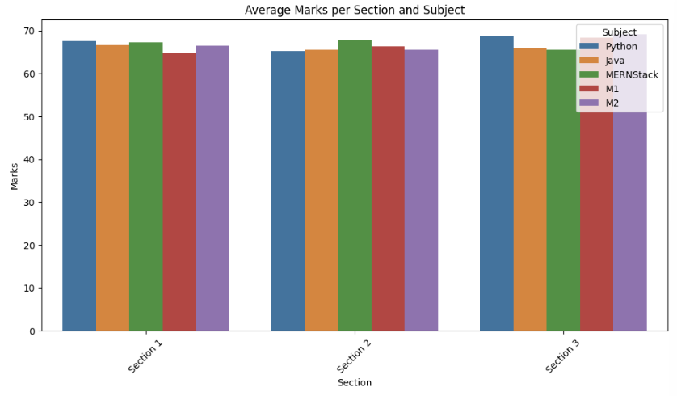
Average Marks per Section & Subject
Include bar plot showing average marks for each section with subjects as different colors.
Observation: Some sections perform better in certain subjects.

Slide 7
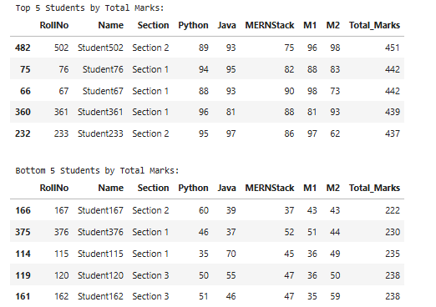
Top & Low Performers
Include tables or screenshots showing top 5 and bottom 5 students by total marks.
Observation: Top performers can be recognized; low performers need support.
Suggestion: Peer mentoring, extra classes, or remedial sessions.

Slide 8
Conclusion
Tailored teaching strategies per section and subject.
Peer-learning programs to strengthen weak students.
Recognize top performers for motivation.
Data-driven academic planning for improvement.

